Slide 1
Recommentation Engine Predictive modelling
Presented by:
Abinesh Kanagarajan

Slide 2
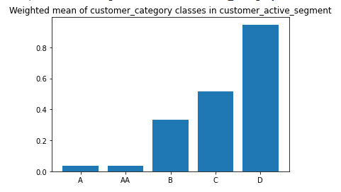
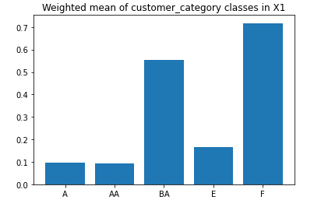
Pros of the model 1) Direct interpretability of output classes with respect to the categories of categorical features.
* Weighted mean of categorical features gives us a meaning full insights of the categories which provides us further scope to research on this event.

Slide 3
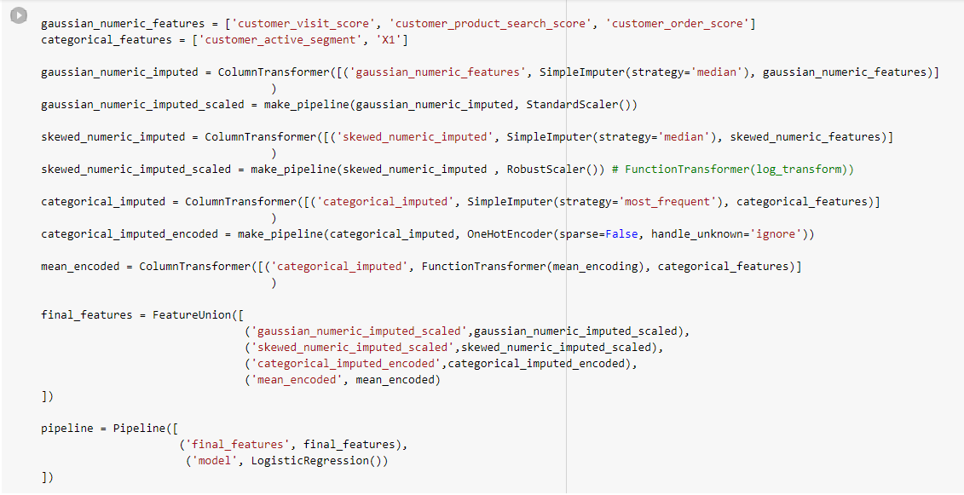
2) ML Pipelines * Building the model using pipelines gives us clear readability of all the feature engineering and feature extraction steps and also it automates all these steps while prediction.

Slide 4
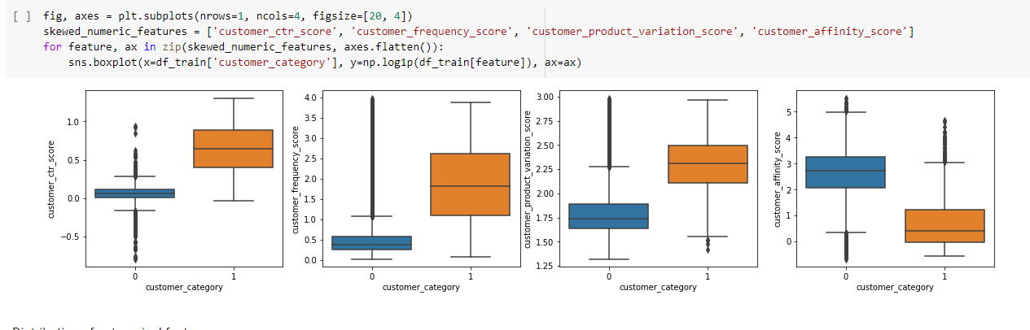
3)Distribution of skewed features * We can see that there is a clear isolation between the classes of the target when the skewed features are taken in log scale. So the outliers of this ditribution have a meaning full information which again helps in prediction.

Slide 5
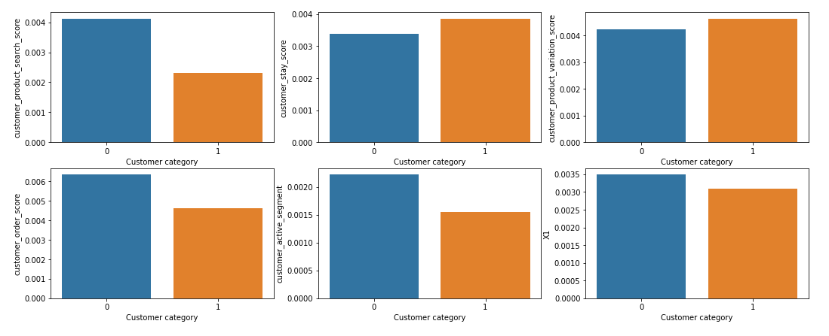
4) Missing values * Our model is robust enough to make the prediction even in the absence of some below mentioned features

Slide 6
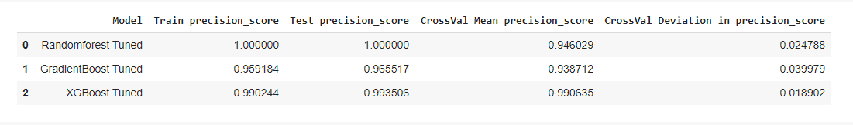
5) Performance of the model * We are able to attain the best performance metrics with least cross validation score deviation and also it performed good in the test data. So we could build a more reliable model.

Slide 7
Cons of the model
1) We are training the model on a imbalanced dataset and also working on precision as a evalutaion metrics. So our model may have more false positive or negative rates. Over sampling the minority class and using F1 score as evaluation metrics may solve this issue.
2) Prediction with the missing values in input data may not be much reliable always.

Slide 8
Architecture for the Deployment of Recommendation Systems
Mobile Application for recommendation
Webapp for recommendation
Feedback with updated dataset
AWS Cloud
Flask Framework to create API
Dataset for training
Machine Learning Model
CICD Pipeline

Slide 9
Steps involved:
Our main objective with the given architecture is to build a recommendation system which will learn continuously and improve its prediction on each iteration.
We will start our training with the initial given dataset using the machine learning model we build.
An API is build using Flask framework to deploy this trained model which can be called by any external applications.
Entire API and model details are stored in cloud service like AWS.
Web/Mobile applications calls this API to provide recommendations to the user.
Based on the user's clicks on the recommendations provided by the model, new datasets will be generated which will be stored in cloud.

Slide 10
This new dataset is like a feedback to the model which enhances the reinforcement learning.
Then this new dataset is used for training the model again and this entire process of training the models continuously will be taken care by CICD pipeline.
This new trained model will do better recommendations as it is learned from past feedback.
This cycle keeps on continue to generate new datasets and training new models to provide a robust recommendations systems.

